Slide 1
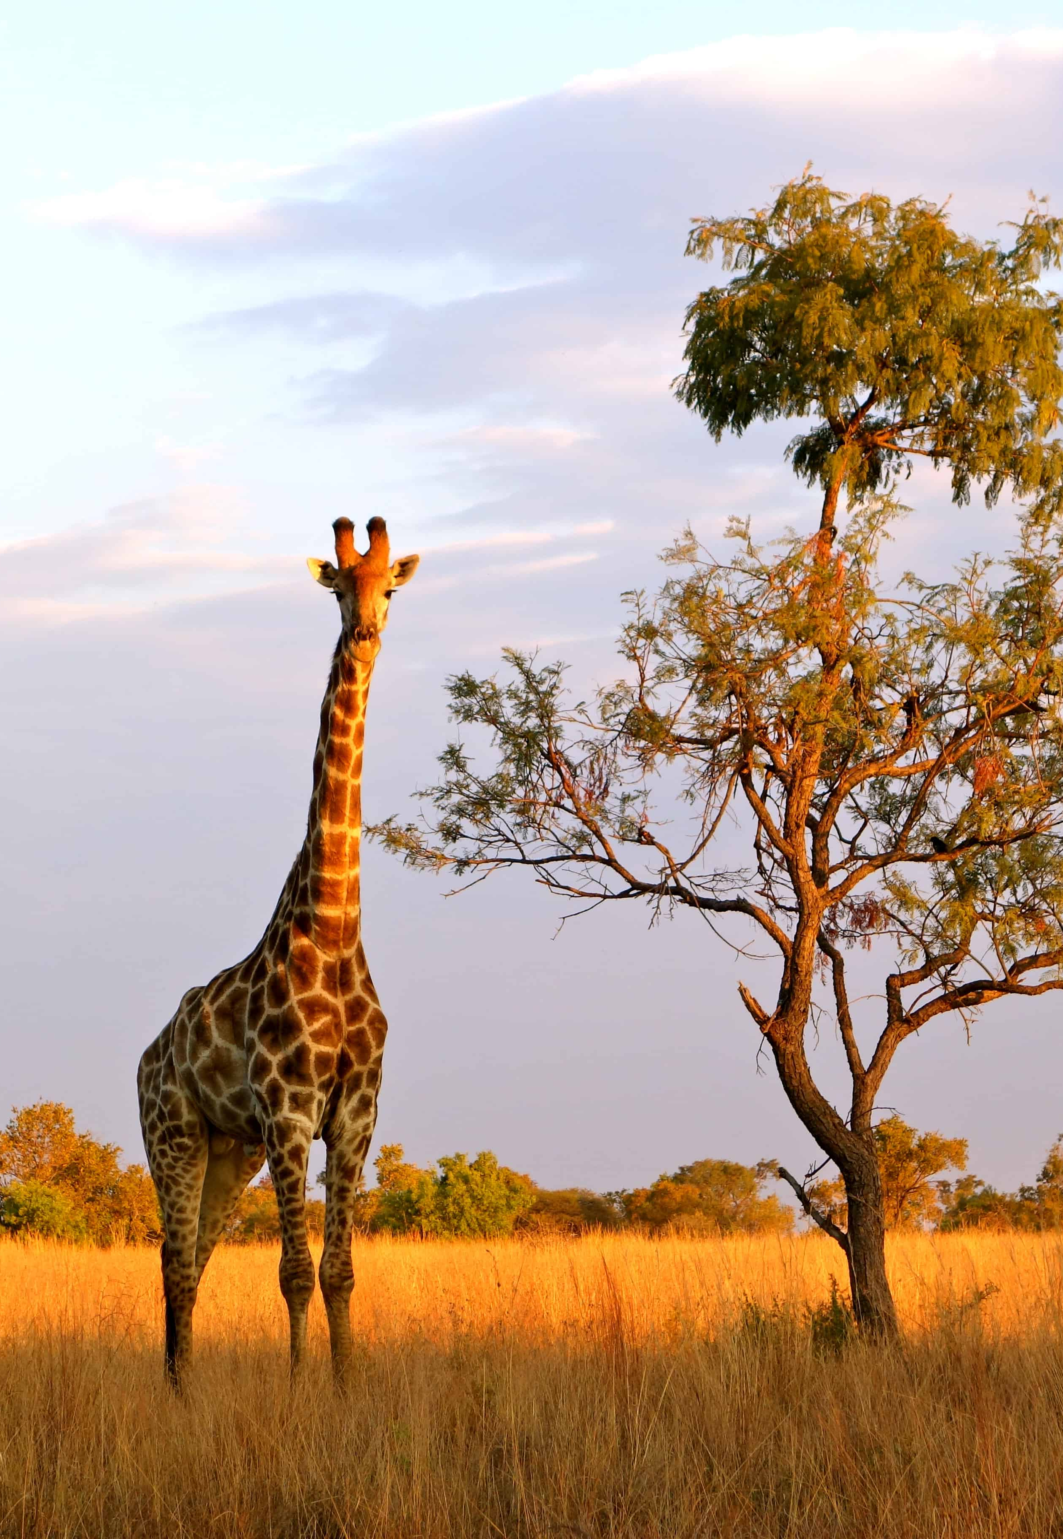









Kukula Global Growth Portfolio
Fact Sheet|Issued 30 October 2025
Investment objective & philosophy
Portfolio information
The Kukula Global Growth Portfolio is a moderate- to high-risk, growth-oriented equity portfolio designed to deliver long-term returns through capital appreciation and dividends. The portfolio seeks exposure to global leaders in sectors driving structural change, including technology, financials, and critical resources, while maintaining diversification across regions and industries.
We invest in responsible, high-quality companies with strong fundamentals, sustainable growth prospects, and sound governance. Our investment process is active and research-driven. Kukula’s portfolio management is characterized by agility, allowing us to swiftly adjust positioning and restructure holdings when market conditions change, protecting value while capturing opportunities in emerging global trends.
Low
Moderate
High
Risk profile:
1 | 2 | 3 | 4 | 5
Portfolio structure
Discretionary/Direct ownership
Inception date
Benchmark
6 Sep 2021
ACWI
Portfolio denomination
USD
Management fee
1% p.a. incl. VAT
Top 5 holdings
Portfolio performance since inception
Name | % of NAV
TSMC - ADR | 8.60%
NVIDIA Corp. | 8.16%
First Quantum Minerals Ltd | 7.94%
JPMorgan Chase & Co. | 7.20%
Meta Platforms Inc. | 6.34%
42.39%
16.65%
9.06%
Total return in USD since inception
Total YTD return in USD
Avg. compounded yearly return since inception
Portfolio return (USD)
Benchmark return (USD)
Portfolio return (ZMW)
Benchmark return (ZMW)
Portfolio volatility
Metric | Portfolio | Benchmark
Mean monthly return | 0.88% | 0.80%
Std Dev (Monthly) | 5.57% | 4.50%
Annualized Volatility | 19.30% | 15.58%
Sharpe ratio | 0.47 | 0.57
Monthly return in USD %
Year | Jan | Feb | Mar | Apr | May | Jun | Jul | Aug | Sep | Oct | Nov | Dec | FY/YTD
2021 |  |  |  |  |  |  |  |  | -8.63% | 10.20% | -5.74% | -0.26% | -5.33%
Benchmark |  |  |  |  |  |  |  |  | -5.10% | 5.39% | -2.31% | 3.89% | 1.51%
2022 | -6.33% | -0.94% | 3.95% | -9.39% | 3.63% | -10.65% | 5.98% | -1.86% | -12.00% | 1.74% | 10.47% | -2.94% | -19.21%
Benchmark | -4.55% | -3.06% | 1.94% | -8.07% | 0.45% | -8.11% | 7.07% | -4.36% | -9.39% | 6.35% | 8.34% | -4.61% | -18.39%
2023 | 10.66% | -3.12% | 3.21% | -1.04% | 1.81% | 6.37% | 4.66% | -4.26% | -5.26% | -6.17% | 8.68% | 4.45% | 19.90%
Benchmark | 7.50% | -3.32% | 3.33% | 1.57% | -1.05% | 5.78% | 3.60% | -2.91% | -4.28% | -2.54% | 8.89% | 4.81% | 22.27%
2024 | 1.90% | 9.52% | 4.27% | -3.47% | 7.80% | 2.79% | -2.29% | 1.85% | 4.00% | 0.79% | 4.71% | -2.10% | 33.11%
Benchmark | 0.28% | 4.51% | 3.26% | -3.55% | 4.58% | 2.04% | 1.54% | 2.50% | 2.20% | -2.09% | 4.03% | -2.66% | 17.45%
2025 | 2.41% | -0.87% | -4.63% | 0.97% | 7.00% | 4.41% | 1.18% | 1.71% | 3.80% | NA | NA | NA | 16.65%
Benchmark | 3.14% | -0.30% | -3.67% | 0.52% | 5.69% | 4.81% | 1.06% | 2.68% | 3.60% | NA | NA | NA | 18.56%
Portfolio and benchmark returns are not for the complete month of September 2021. Starts at 6 September 2021 (inception). Benchmark YTD is since inception.
All returns stated have been calculated based on net asset values, including reinvestment of dividends where applicable. Past performance is not a reliable indicator of future performance.
assetmanagement@kukulacapital.com www.kukulacapital.com +260 954 715 547
1

Slide 2



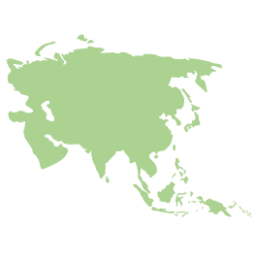

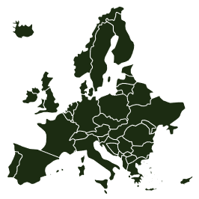











Kukula Global Growth Portfolio
Fact Sheet|Issued 30 October 2025
Distribution per sector
Distrubution per region
Utilities
Cash
Transportation
Asia
Cash
Europe
Healthcare
Consumer discretionary
Africa
Financial services
Materials
Technology
Consumer staples
North America
Manager’s commentary and outlook
Fee details
As of September 30, 2025, the portfolio has delivered a year-to-date return of 16.65%, reflecting a solid performance against a backdrop of market volatility, particularly within the technology sector, which constitutes 30.1% of our allocations. Key contributors to this performance include significant holdings in leading firms such as TSMC and NVIDIA, although recent headlines have highlighted challenges faced by AI infrastructure companies, with NVIDIA experiencing a notable decline. The portfolio's return since inception stands at 42.39%, outpacing the benchmark's compounded annual growth rate of 8.83%, underscoring our strategic focus on high-growth sectors. However, we remain vigilant regarding potential risks, especially the recent market turbulence stemming from geopolitical tensions and regulatory scrutiny in various sectors, including energy and technology. The environmental concerns surrounding major gas producers and the unfolding situation regarding the Mozambique gas project signal the need for cautious monitoring. As we look forward, we will continue to assess sector dynamics and regional developments, ensuring our strategy remains aligned
Portfolios are managed on a discretionary basis and are subject to the following fees:
Item | Value
Annual Management Fee (Incl. VAT) | 1 %
Performance Fee | None
Transaction Costs & Commissions | See schedule
Risk profile: Moderate to high
The portfolio invests exclusively in equities.
Suitable for medium- to long-term investment horizons.
Exposed to market risk and broader economic fluctuations.
Offshore holdings may introduce additional currency risk.
Custody arrangement
All securities are held with CITI Group in the name of Saxo Bank and segregated in the name of DMA Mauritius. A full sub-register is maintained for the beneficial owner of the assets, which are reported live via the available platforms. Positions are settled daily and reconciled against the custodian.
Investment platform
Kukula uses the Saxo Bank/DMA platform. Investors are responsible for the associated platform fees and transaction costs.
Disclaimer
This document should not be seen as an offer to purchase any specific product and is not to be construed as advice or guidance in any form whatsoever. Investors are encouraged to obtain independent professional investment and taxation advice before investing with or in any of Kukula’s Asset Management products. Kukula Capital reserves the right to close the portfolio to new investors and reopen certain portfolios from time to time in order to manage them more efficiently. Investments in foreign securities may include additional risks such as potential constraints on liquidity and repatriation of funds, macroeconomic risk, political risk, foreign exchange risk, tax risk, settlement risk as well as potential limitations on the availability of market information. Past performance is not an indication of future performance.
Kukula Capital is a Fund Manager regulated by the Securities and Exchange Commission of Zambia
assetmanagement@kukulacapital.com www.kukulacapital.com +260 954 715 547
2

